Slide 1
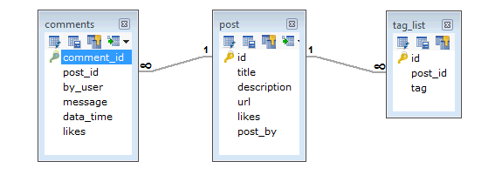
MongoDB - Data Modeling
Database design for his blog/website, In RDBMS schema, design for below requirements will have minimum three tables.
Every post has the unique title, description and url.
Every post can have one or more tags.
Every post has the name of its publisher and total number of likes.
Every post has comments given by users along with their name, message, data-time and likes.
On each post, there can be zero or more comments

Slide 2
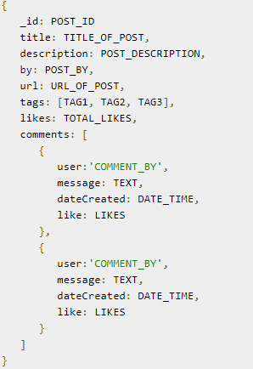
MongoDB - Data Modeling
In MongoDB schema, design will have one collection post and the following structure
So while showing the data, in RDBMS you need to join three tables and in MongoDB, data will be shown from one collection only.

